Slide 1

Cells, proteins and biocompatibility
Louisiana Tech University
College of Engineering and Science
BIEN 235
Dr. Teresa Murray

Slide 2
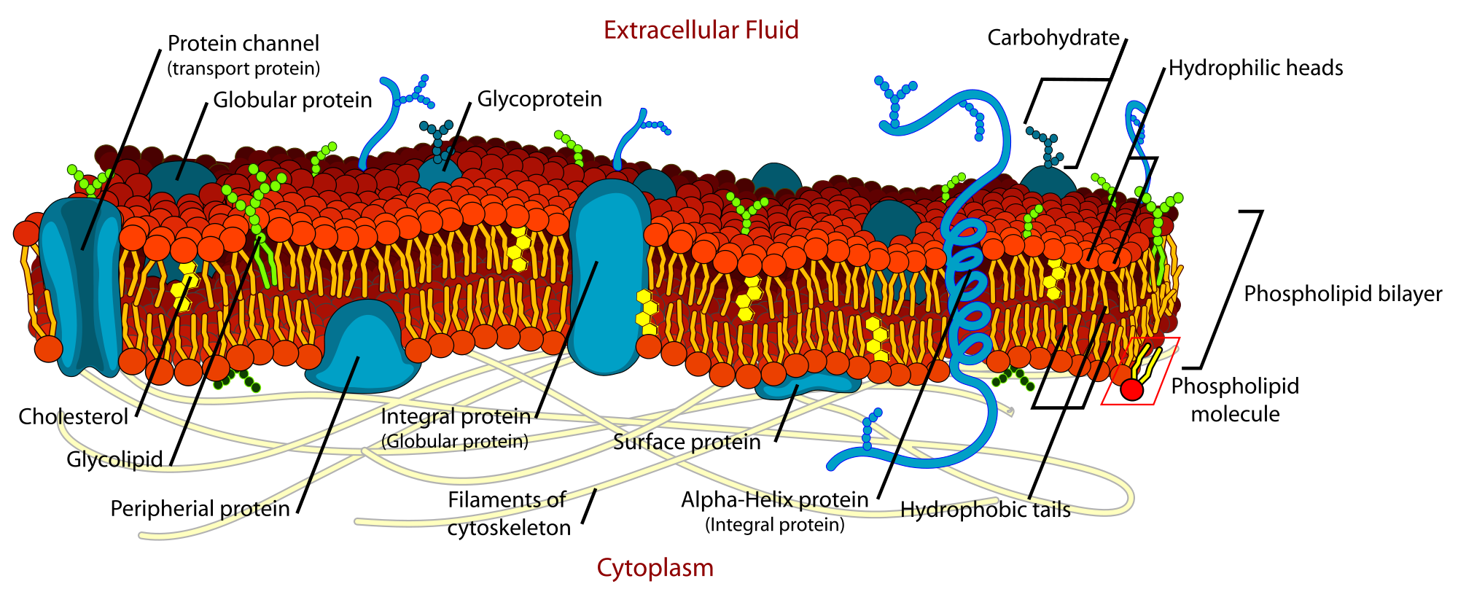
Membrane of Cells
Part II MEDICAL
Chap 16 Cell
All cells are bounded by a membrane called plasma membrane, which serves as a dynamic interface between the internal environment of the cell and the external environments.
Cell Structure: http://www.youtube.com/watch?v=PXbv95P3uhI
http://www.youtube.com/watch?v=fNyq4A08mTo
http://espanol.video.yahoo.com/watch/40408/808847

Slide 3
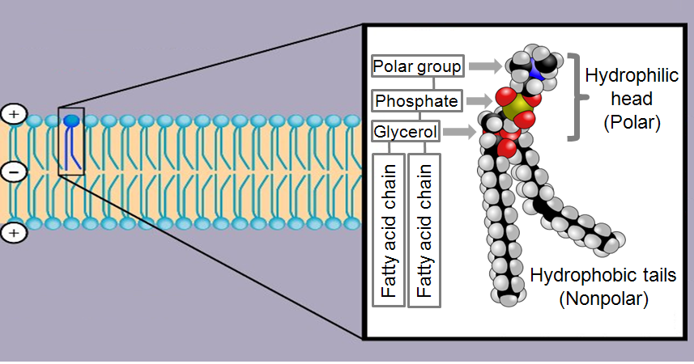
Cell Membrane: Lipid bilayer
Part II MEDICAL
Chap 16 Cell
Cells like water and tend to anchor on hydrophilic substrates –An important aspect in designing the surfaces of biomaterials.

Slide 4
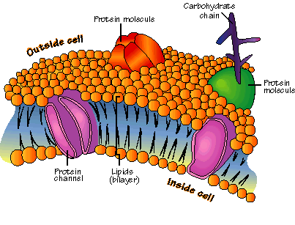
Membrane Mosaic Model
Part II MEDICAL
Chap 16 Cell
The embedded protein molecules, which are referred to as protein complexes, make up almost 50% of the total mass of the membrane, representing a mosaic model of membrane structure.
Proteins include channels, enzymes, receptors and adhesion molecules, which all have specific parts of their amino acid sequence that anchor it into the hydrophobic region.

Slide 5
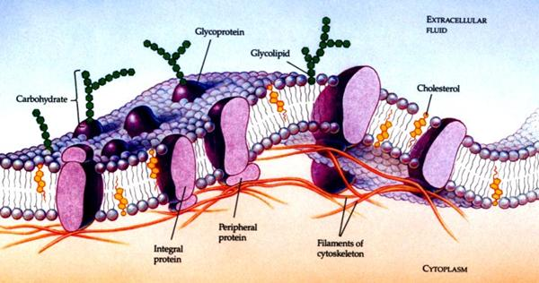
Receptors
Part II MEDICAL
Chap 16 Cell
On the external surface of the plasma membranes, many of the membrane proteins and lipids are conjugated with short chains of polysaccharide, the combinations called glycoprotein and glycolipids
These glycoprotein and glycolipids are called receptors. They participate in important interactions such as cell adhesion, recognition and response to protein hormones (cell communication).

Slide 6
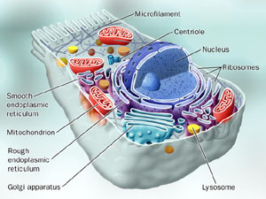
Nucleus, Cytoplasm, Cytoskeleton
Part II MEDICAL
Chap 16 Cell
Inside cell membrane, the cell is composed of three basic parts: nucleus,
cytoplasm & cytoskeleton
Both the cytoplasm and nucleus contain a number of sub-cellular elements, called organelles.

Slide 7
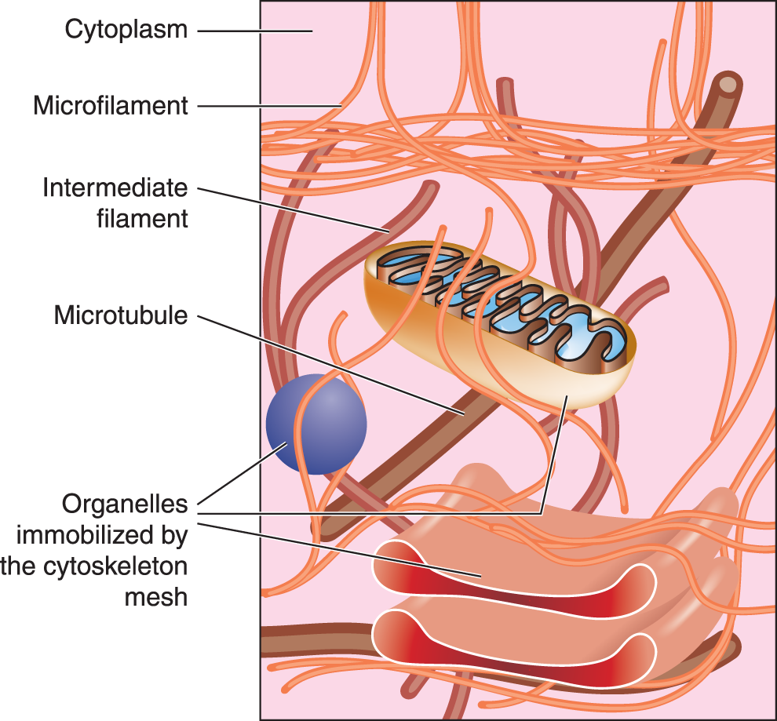
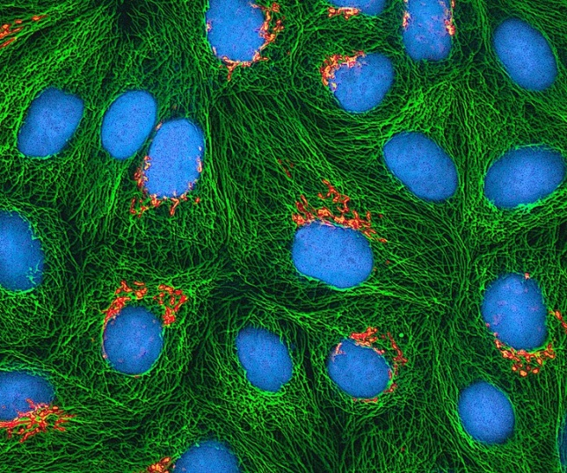
Cytoskeleton
Part II MEDICAL
Chap 16 Cell
Within the cytosol, there is a network of minute tubules and filaments, collectively known as the cytoskeleton, which provides structural support for the cell and its organelles, as well as providing a mechanism for transfer of materials within the cell and movement of the cell itself.

Slide 8
Transport Across Plasma Membranes
Part II MEDICAL
Chap 16 Cell
Transport of materials across the plasma membrane occurs by four principle mechanisms.
Passive diffusion
Facilitated diffusion (with gradient)
Active transport (against the gradient)
Bulk transport (example: phagocytosis)
Notes:
Use homogeneity diffusion for passive, vacuum pump as active. one cleaning mechanism debris of biodegradable biomaterials

Slide 9
Passive Diffusion
Part II MEDICAL
Chap 16 Cell
Net movement of material from an area of high concentration to an area with lower concentration is said to move by passive diffusion, either across a membrane or from one region to another (e.g between two adjacent tissues). It is driven by the difference in concentration between the two areas, called a concentration gradient.
In short, passive diffusion moves materials down the concentration gradient, without the need to be driven by an external energy source.

Slide 10
Osmosis
Part II MEDICAL
Chap 16 Cell
Biological systems also employ a process called osmosis, where high concentrations of one type of solute (e.g. albumin, ions) accumulate on one side of a membrane, creating a water deficit (i.e. a concentration gradient). So water tries to equalize the pressure by moving across the membrane.
Animation
http://highered.mcgraw-hill.com/sites/0072495855/student_view0/chapter2/animation__how_osmosis_works.html

Slide 11
Facilitated Diffusion
Part II MEDICAL
Chap 16 Cell
Facilitated diffusion is also called carrier-mediated diffusion. It is the movement of molecules across a semi-permeable membrane via micro-scale channel proteins embedded within the membrane, which function as gates or pores to aqueous dissolved molecules.

Slide 12
Why Facilitated Diffusion?
Part II MEDICAL
Chap 16 Cell
The cell membrane is arranged such that the hydrophobic "tail" regions are shielded from the surrounding polar fluid, letting the more hydrophilic "head" regions to associate with water environments.
The arrangement of hydrophilic heads and hydrophobic tails of the lipid bilayer prevents strongly polarized solutes (e.g. amino acids, nucleic acids, carbohydrates, proteins, and ions, except for water) from diffusing across the membrane, but generally allows for the diffusion of hydrophobic (non-polar) molecules. This affords the cell the ability to control the movement of these substances via mosaic protein complexes such as pores and gates.

Slide 13
Example of a Transmembrane Channel
Ligand-gated ion channels
Pore opens due to chemical signaling molecule (or change in membrane voltage potential)
Pore is selective to one type of cation or anion.
Moves
extracellular region
+ + + + - + + - - + + + -
Plasma Membrane
- + - - + - - + - - + - + - - - -
+ + + + - + - + + + + - + -
cytosol
Graphic Animations, Teresa Murray © 2009
Notes:
Developing design criteria: Used literature searches and my own experience with cell culture and brain slice experiments to identify important criteria.
Identified usefulness beyond this project: Existing tools are either not useful or not optimal for answering these questions. Advancing science and potential IP
I will address specific examples throughout the presentation. In general, the tools developed in this project are expected to impact three of the broad areas of research.
Advancing science: Basic science (Peering into the black box.) – Examples: What happens and why, and what perturbs it? Providing new tools that will have uses beyond the questions being asked in this dissertation research project.
Engineering: Potential IP - Platform development (explain platform from an engineering perspective) and optimization of the system components. Contrast against one-at-a-time drug discovery and development.
Translational science: Examples – Does this have diagnostic and or therapeutic uses?
(Each of these could take a long time to explain, so I will answer questions regarding this later in the presentation or afterwards.)

Slide 14
Active Transport
Part II MEDICAL
Chap 16 Cell
Active transport involves movement of materials from an area of low concentration to higher concentration, against the spontaneous flow or concentration gradient.
Via facilitated diffusion mechanism and energy
Animation
http://highered.mcgraw-hill.com/sites/0072495855/student_view0/chapter2/animation__how_the_sodium_potassium_pump_works.html

Slide 15
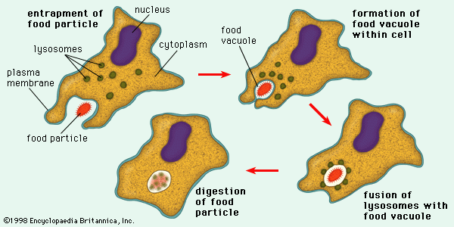
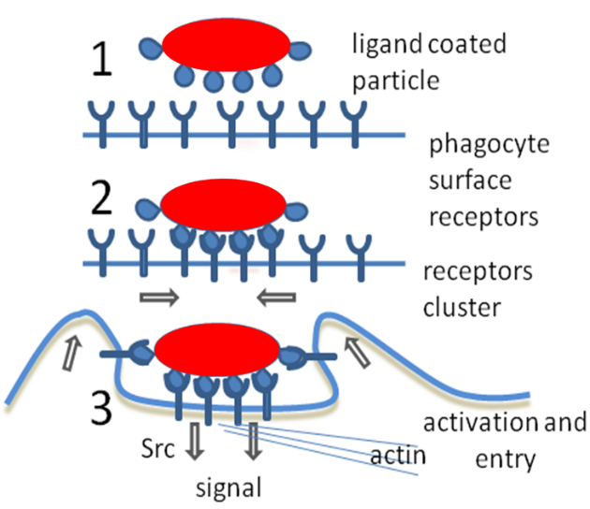
Bulk Transport across Plasma Membranes
Part II MEDICAL
Chap 16 Cell
Transport of large molecules or small particles into the cell occurs by a range of mechanisms collectively known as endocytosis (e.g., phagocytosis).
Notes:
one cleaning mechanism debris of biodegradable biomaterials.
Lysosomes are organelles containing digestive enzymes (acid hydrolases).

Slide 16
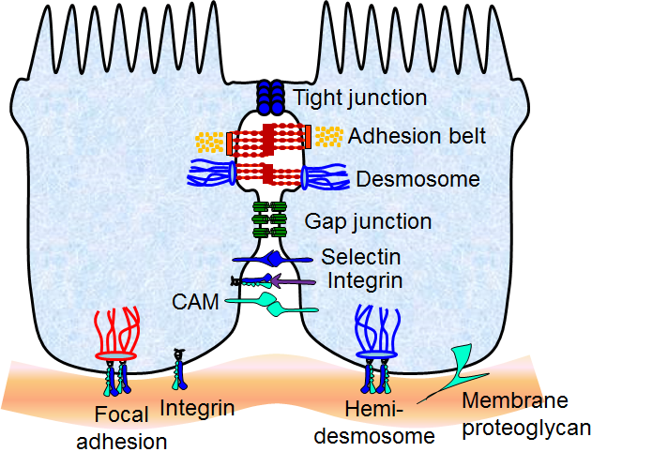
Cell Attachment
Part II MEDICAL
Chap 16 Cell
Cells do not attach directly to other cells, extracellular matrix, and artificial substrates. They bind using cell adhesion molecules such as selectins, integrins and cadherins.
Each type of adhesion molecule has a different function and recognizes different ligands (the binding sites of biomolecules).

Slide 17
Cell Aging
Part II MEDICAL
Chap 16 Cell
Normal tissue specific cells have a limited number of cell cycles (typically 20-80).
Natural aging and death of cells is genetically pre-programmed, which in the human correlates with a life span of approximately 70 years. Many tissue types already begin to show morphological signs of senescence in middle age, including skin tissue, that begin to senesce in middle age. Cell cycles also slow down, so that the regenerative capacity of tissues gradually declines with age as well.

Slide 18
Natural Cell Death
Part II MEDICAL
Chap 16 Cell
Natural aging and death of cells is gene programmed. Natural death of cell is called apoptosis.
Apoptosis is also important for body functions and health.
Uncontrolled cell proliferation leads to cancer.
Notes:
We all get old with time. The mechanism of aging is based in the cells.

Slide 19
Unnatural Death: Necrosis
Part II MEDICAL
Chap 16 Cell
Necrosis is the premature death of cells and living tissue.
Necrosis is caused by external factors, such as infection, toxins or trauma.
Apoptosis/Necrosis is defined by the cause of cell death, NOT by the age of cells.

Slide 20
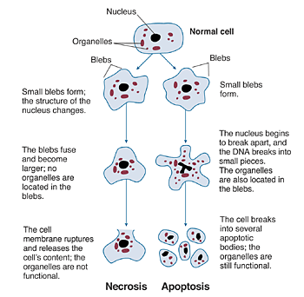
Apoptosis vs Necrosis
Part II MEDICAL
Chap 16 Cell
Either apoptosis or necrosis can be identified morphologically using histological techniques

Slide 21
Cell Differentiation
Part II MEDICAL
Chap 16 Cell
Cellular differentiation is the process by which a less specialized cell becomes a more specialized cell type.
A cell that is able to differentiate into more than one cell types is known as stem cells.

Slide 22
Somatic Stem Cells
Part II MEDICAL
Chap 16 Cell
Some stem cell types (so-called fetal derived stem cells) have been derived from fetal blood progenitors present in the umbilical cord (e.g. cord blood stem cells).
Stem cells found throughout the body after most of the organism has developed are referred to as adult (somatic) stem cells.
Bone marrow stem cells
adipocyte progenitors
induced pluripotent stem cells (iPSCs)

Slide 23
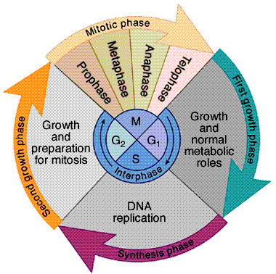
Cell Proliferation: Cell Cycle
Part II MEDICAL
Chap 16 Cell
The cell cycle, or cell-division cycle, is the series of events that take place in a cell leading to its division and duplication (replication):
First growth phase
DNA replication
Second growth phase
Mitotic phase
You will not need to memorize steps in the mitotic phase

Slide 24
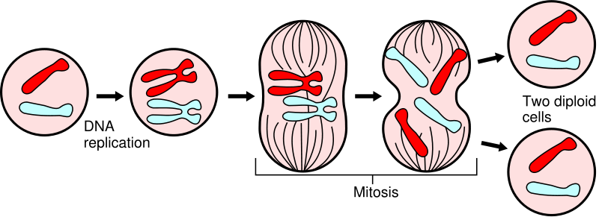
Mitosis
Part II MEDICAL
Chap 16 Cell
Cell division is also called mitosis.
Video of cell division:
http://www.youtube.com/watch?v=aDAw2Zg4IgE
http://www.youtube.com/watch?v=rgLJrvoX_qo

